Slide 1
Large-scale Datasets and Modeling Tools from the Allen Institute for Brain Science
Yazan N. Billeh
yazanb@alleninstitute.org
Notes:
Choose one of slides 1-4 as your title slide

Slide 2

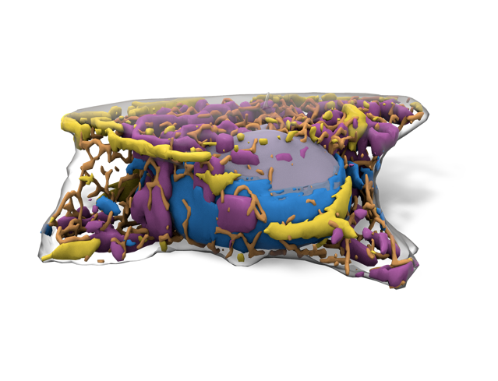
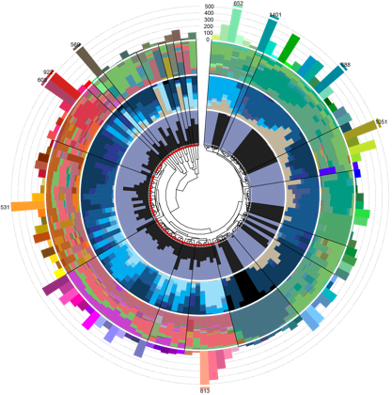

Established 2003 by Paul G. Allen
South Lake Union, Seattle, WA
500 employees++
hard problems
complexity
foundational biology
big science
team science
open science
data
knowledge
tools
brainscience.alleninstitute.org | 2

Slide 3
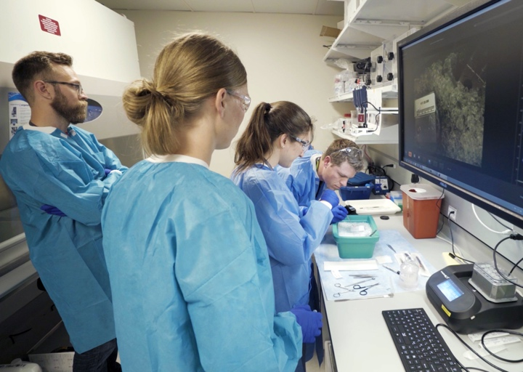
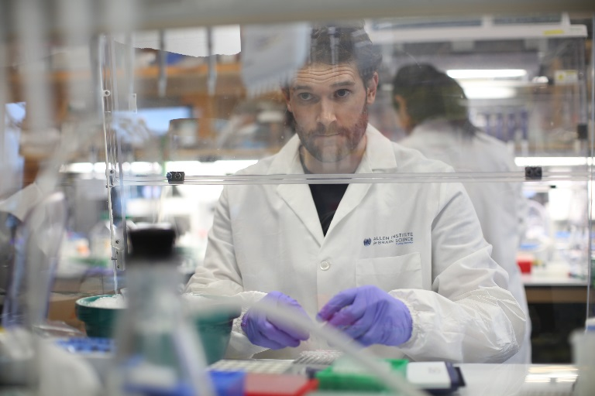
CORE PRINCIPLES
Team Science
Interdisciplinary teams working towards common goal
Big Science
Large-scale projects with robust, massive data
Open Science
All resources available online at brain-map.org or allencell.org

Slide 4
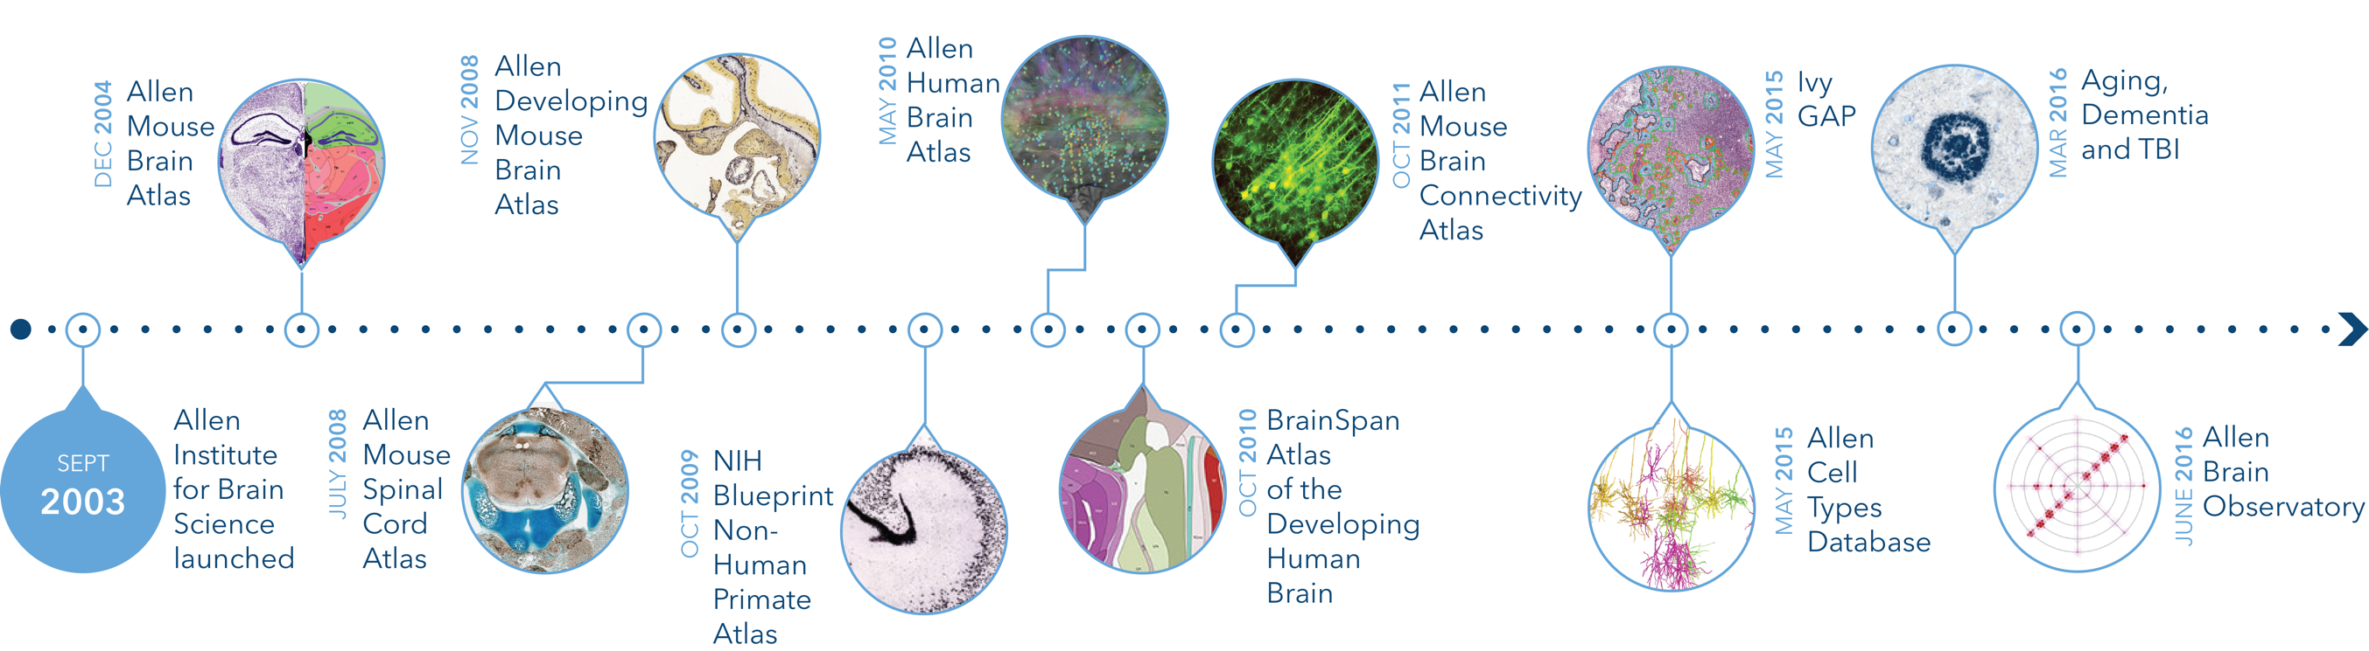
Allen Institute - Online Public Resources www.brain-map.org
All data are:
publicly accessible via API as soon as they pass QC
freely available without any commercial restrictions

Slide 5
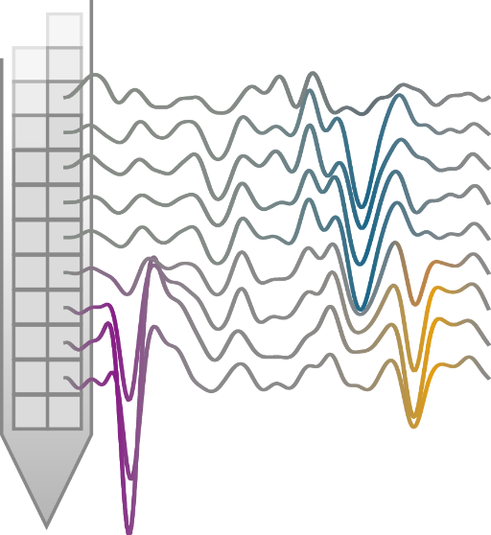
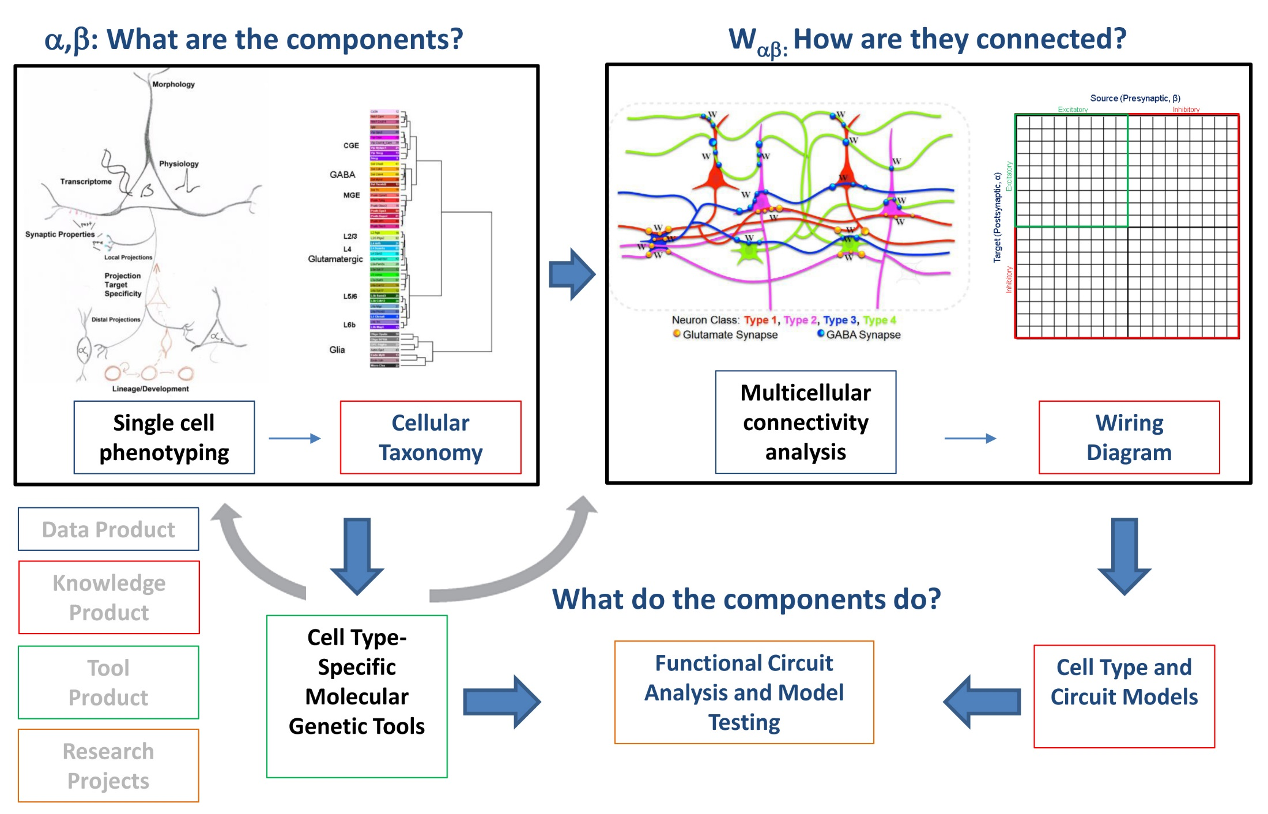
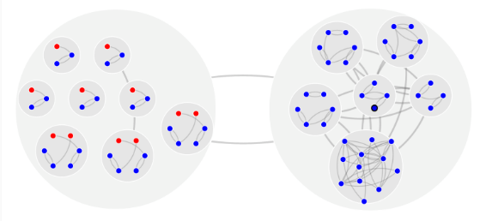
Institute Programs
BrainTV
Cell Types
Product

Slide 6
Cell Types Program
Characteristics of cells and connections
BrainTV
Cell Types
Product

Slide 7
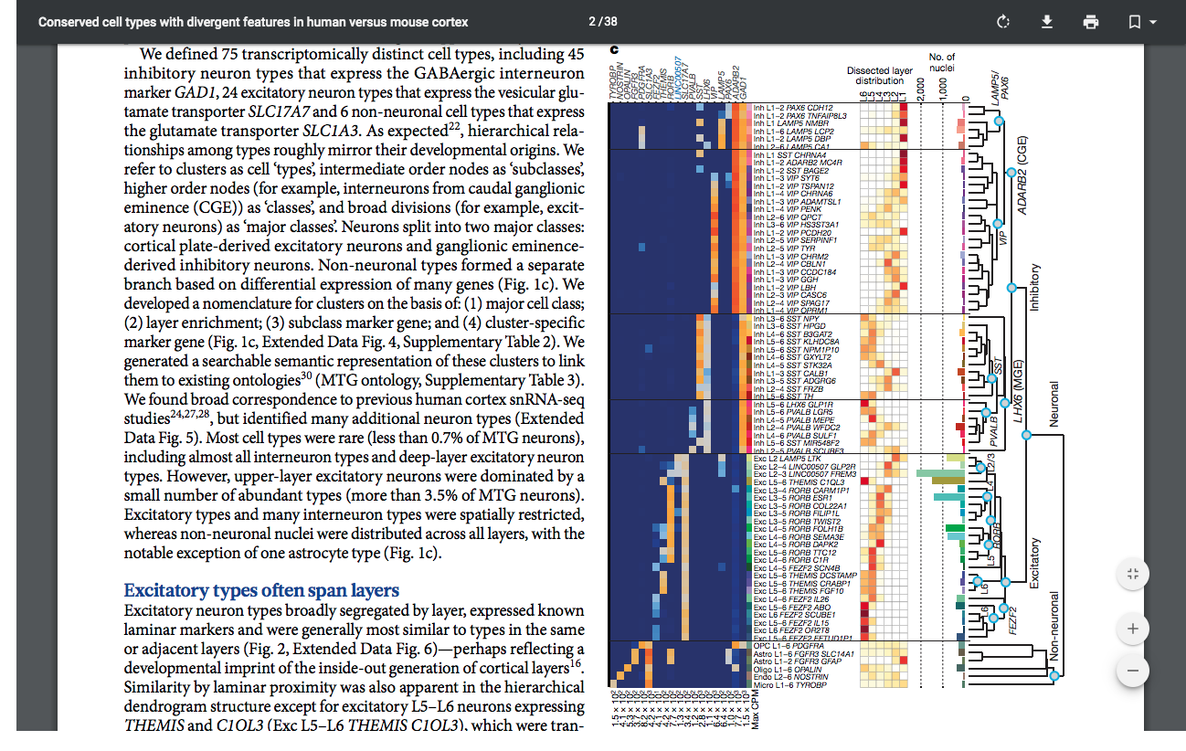
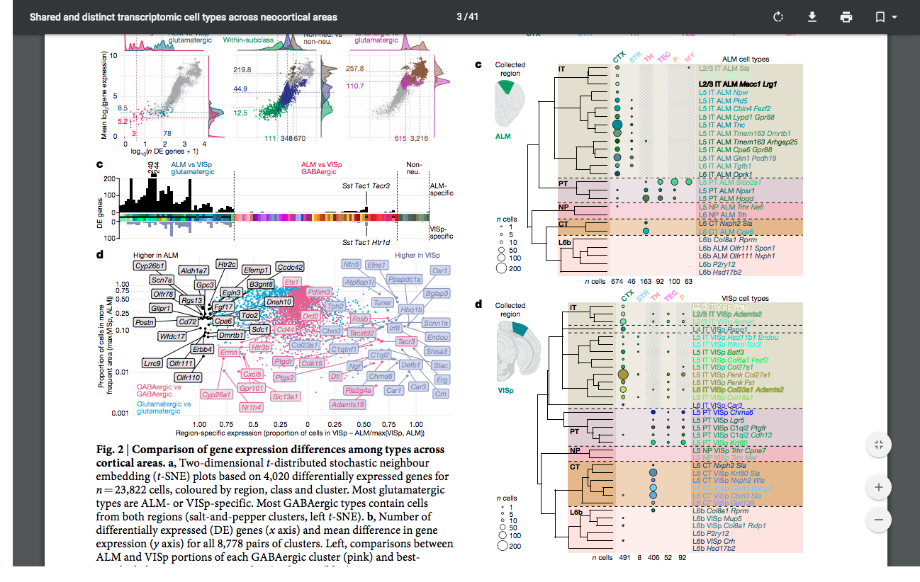
Transcriptomics (Mouse and Human)
Deliverables: Single-cell transcriptomic data for mouse and human cortical cells, transcriptomic cell type taxonomy.
Scope: Tens of thousands of cells.
Tasic et al., Natutre, 2018; Hodge, Bakken,et al., Nature, 2019

Slide 8
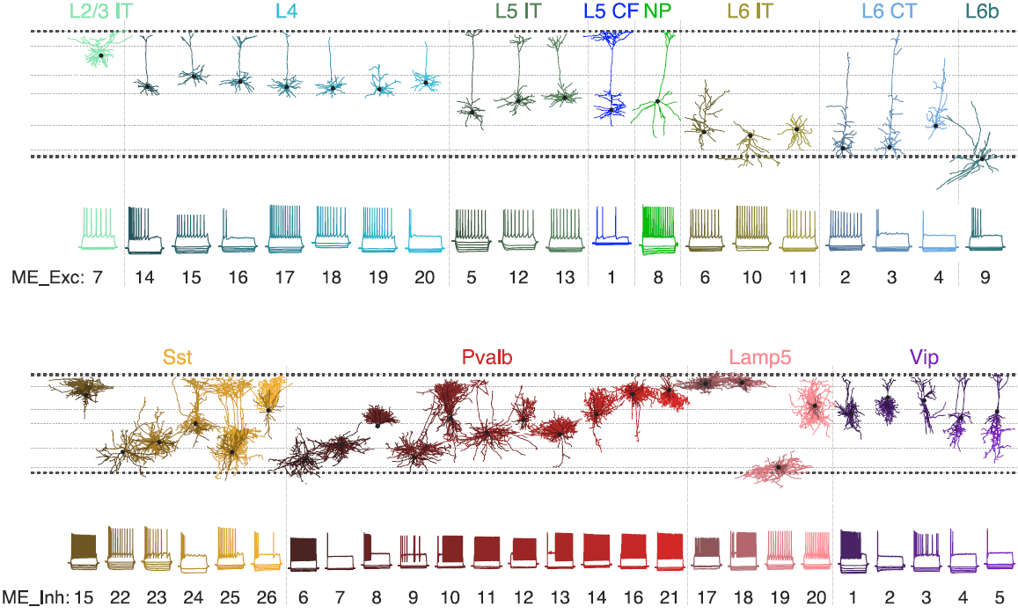
Electrophysiology and Morphology of Neurons in Vitro (Mouse and Human)
Deliverables: E-phys and morphology data, as well as models, for cortical cells; morphological and physiological classification of cell types.
Scope: Thousands of cells in the mouse visual cortex and human middle temporal gyrus (MTG).
Gouwens et al., Nature Neurosci., 2019

Slide 9
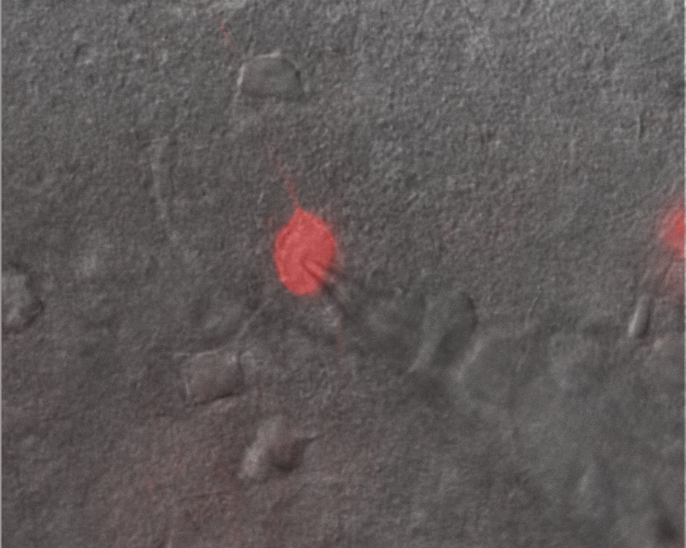
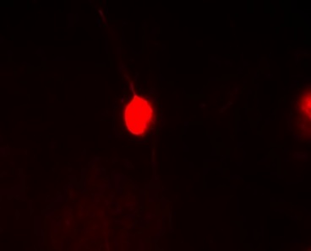
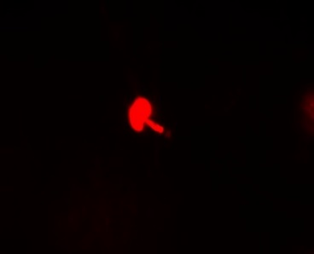
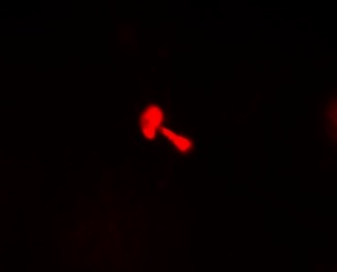
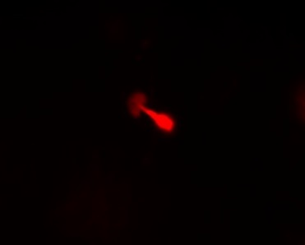
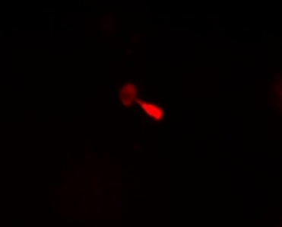
Mouse and Human Patch-Seq
Deliverables: Transcriptomic, E-phys, and morphology data, as well as models, for mouse and human cortical cells.
Scope: Thousands of neurons in mouse and human.
Mouse subcortical cell
Mouse cortical cell
Human cortical cell

Slide 10
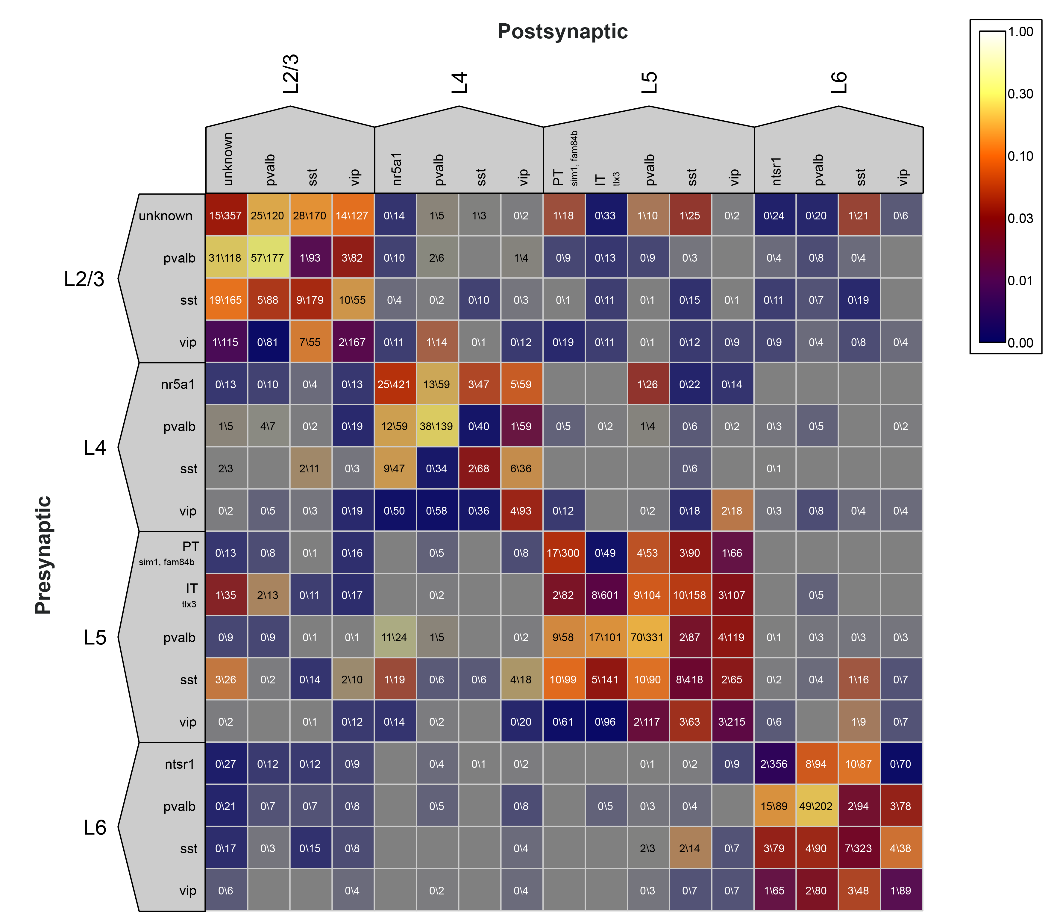
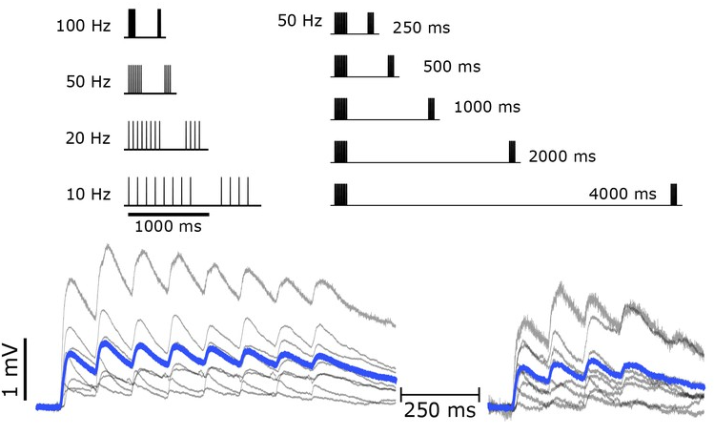
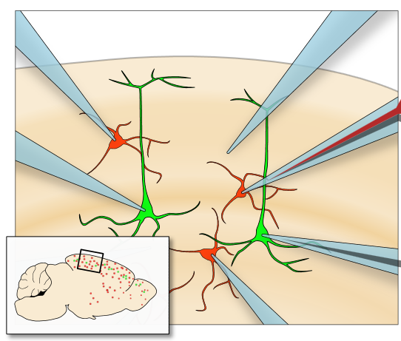
Mouse and Human Synaptic Physiology
Deliverables: Connection probabilities, synaptic strength, and short-term plasticity properties for connections between cortical cell types in mouse and human.
Scope: approximately 10x10 matrix (i.e., ~10 “cell types”) in mouse and as close to this plan as possible in human. Expand to study specific cell types and correspondence of transcriptome to connectivity in later years.
Seeman et al., eLIfe., 2018

Slide 11

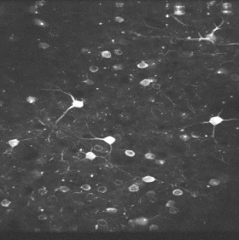
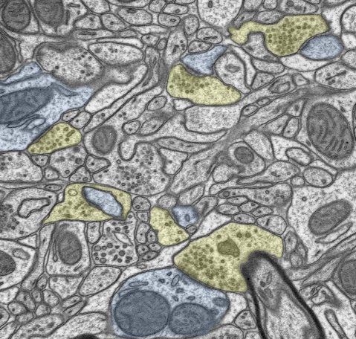
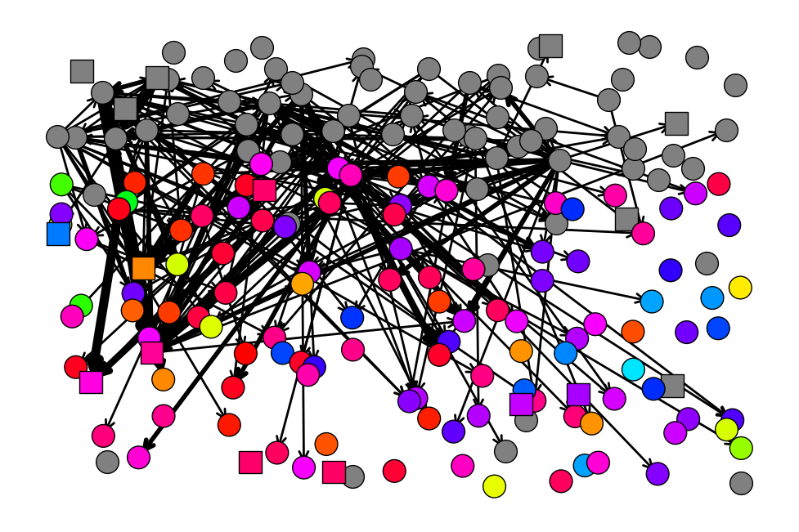
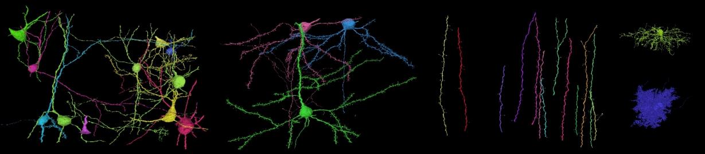
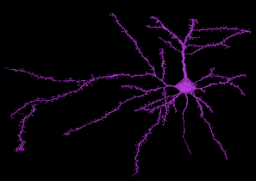
Mouse and Human EM Connectomics
Deliverables: Reconstruction of neuronal morphologies and the connectivity matrix in the local cortical circuit – 1 mm³ in mouse V1 and 2 mm³ in human MTG.
Scope: ~100,000 neurons (in the mouse, many of the neurons would be functionally characterized in vivo).
Wiring Diagram
Cell Types
Automated reconstructions are by Sebastian Seung Lab, Princeton University

Slide 12
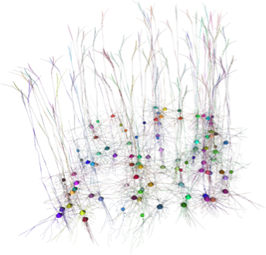
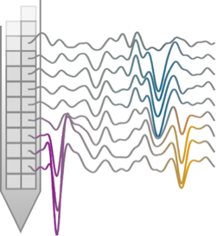
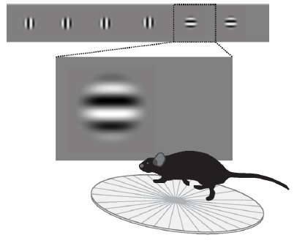
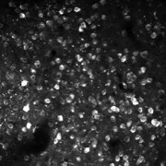
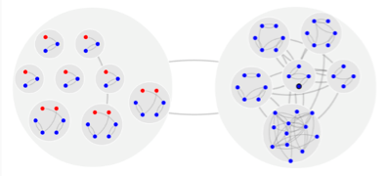
BrainTV Program
Activity and Computations in Cortical Circuits in Vivo
Biophysical Modeling
Ephys – Neuropixels Probes
BrainTV
Cell Types
Visual Behavior
Product
2p Cellular Imaging
Point Neuron &
Filter Networks

Slide 13
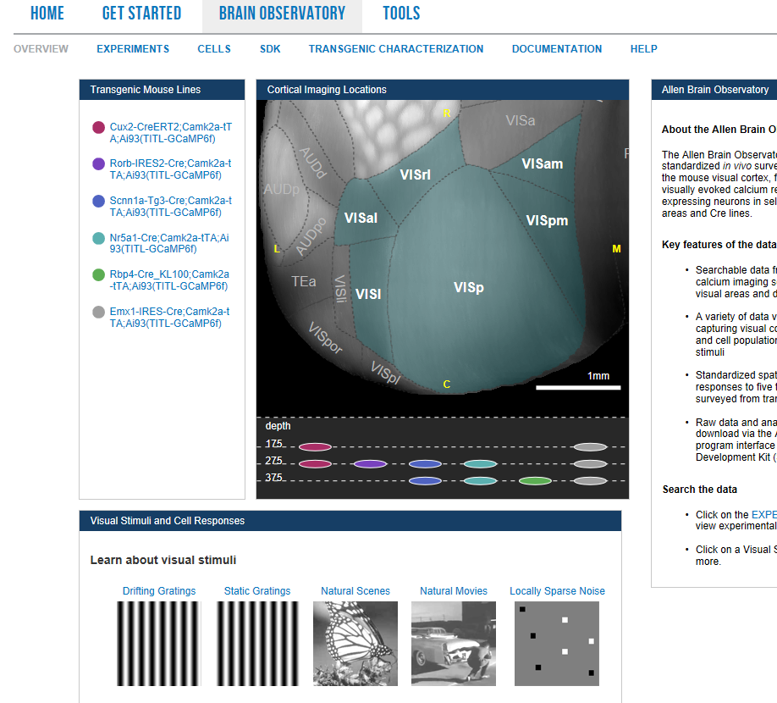
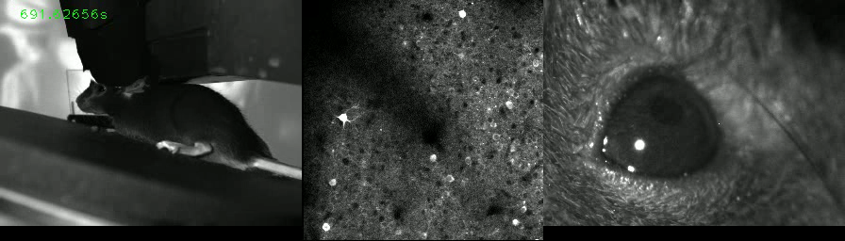
Visual Coding
Deliverables:
O-phys data for neuronal responses in the mouse cortex in vivo.
Scope:
Over sixty thousands cells recorded
Allen Brain Observatory
http://observatory.brain-map.org/visualcoding
de Vries et al., Nat. Neuro, 2019;

Slide 14
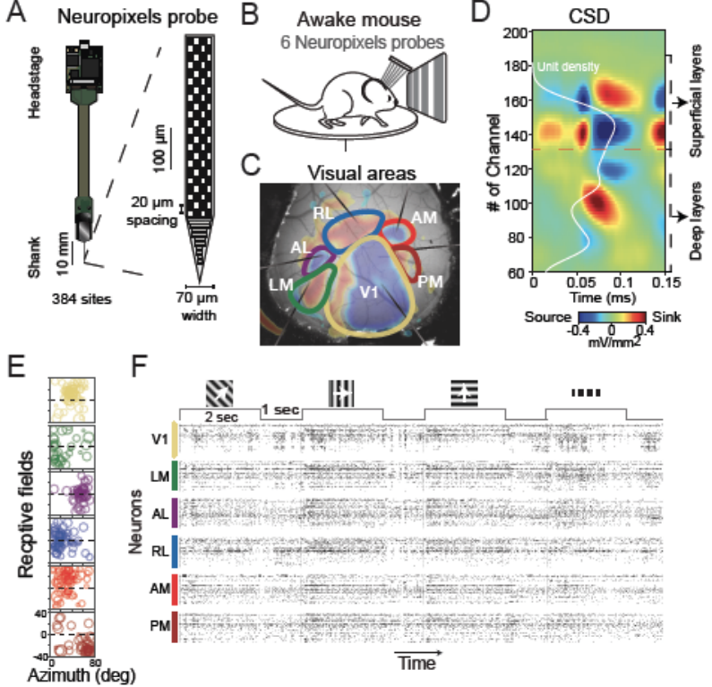
Allen Brain Observatory – in Vivo Electrophysiology
Deliverables:
E-phys data for neuronal responses in the mouse cortex in vivo.
Scope:
Tens of thousands of units for E-phys; subcortical areas also
First Release: October 2019
Jun et al., Nature , 2017

Slide 15
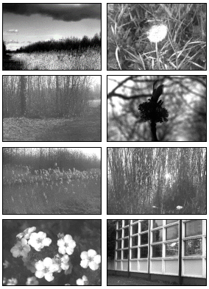
Visual Behavior
Deliverables:
O-phys and E-phys data for single-cell responses in the mouse cortex in vivo, in the context of a change detection behavior.
Scope:
Tens of thousands of cells for O-phys; tens of thousands of units for E-phys.
Garrett et al., BioRxiv, 2019

Slide 16
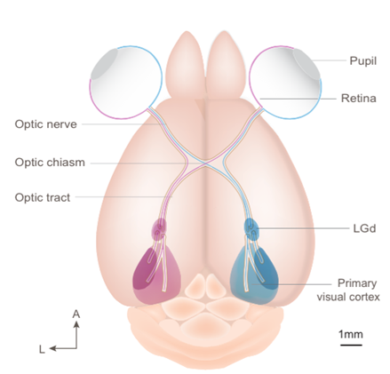
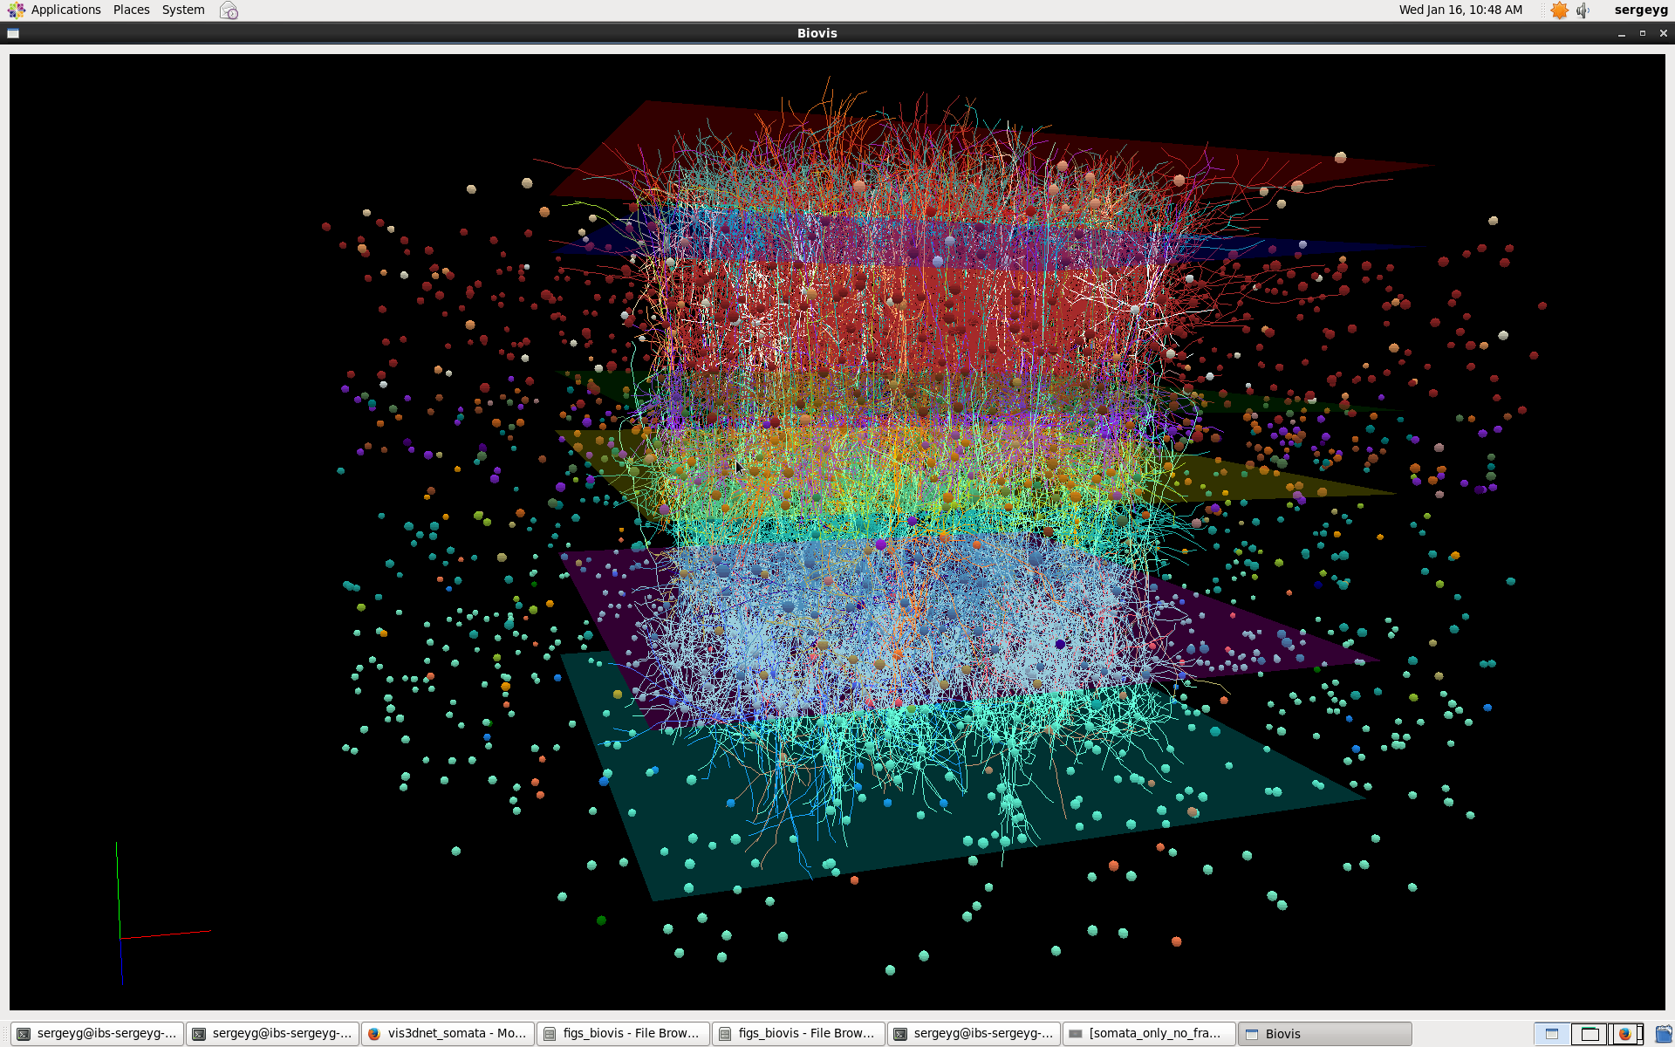
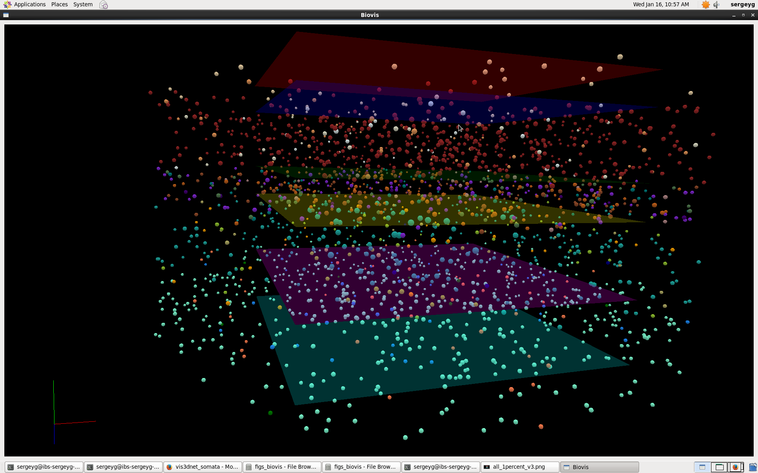
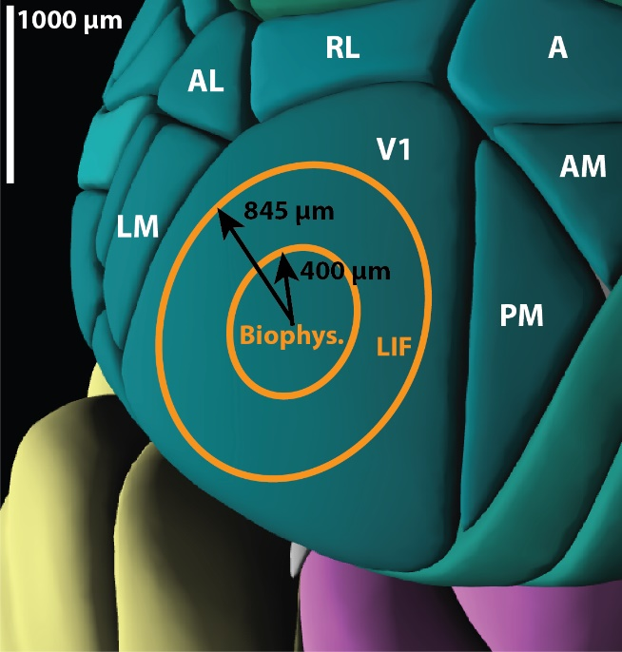
Model of the Mouse Primary Visual Cortex (V1)
Biophysical
Point-neuron
LGN
230,924 cells total
17 cell classes
One-to-one mapping between the biophysical and point-neuron models
Arkhipov et al., PLOS Comp. Bio., 2018; Billeh et al., BioRxiv, 2019

Slide 17
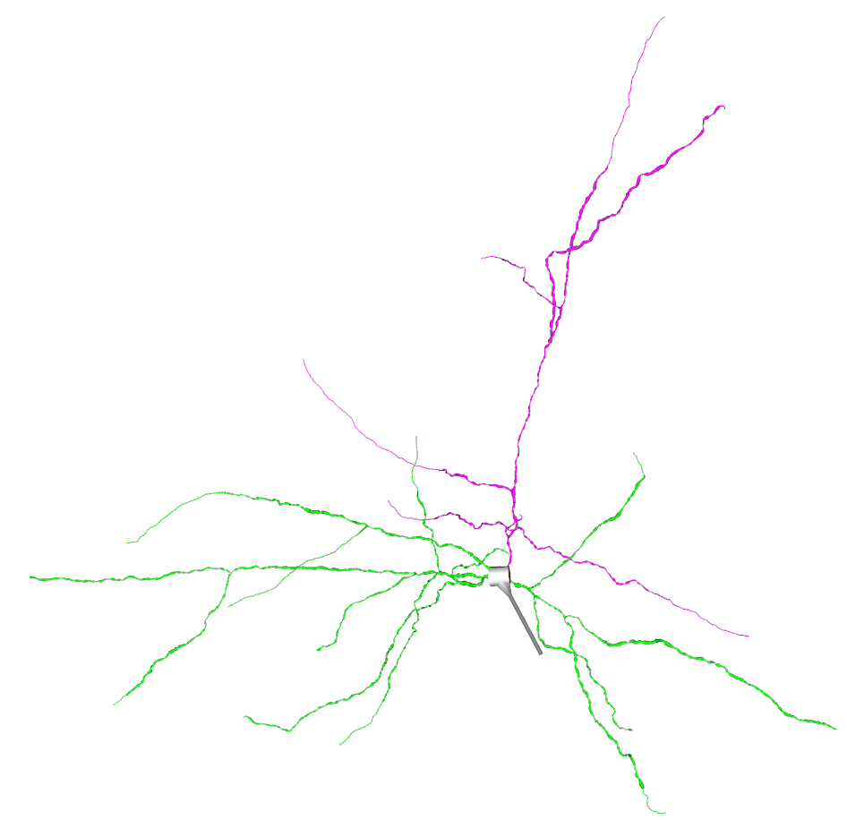
Models of Individual Neurons Allen Cell Types Database: celltypes.brain-map.org
Point models (GLIF)
Mouse: 1058 cells
Human: 157 cells
Compartmental models with
passive dendrites
Mouse: 193 cells
Human: 43 cells
Compartmental models with
active dendrites
Mouse: 73 cells
Gouwens et al., Nature Comm., 2018; Teeter et al., Nature Comm., 2018; Gouwens et al., Nature Neurosci., 2019

Slide 18
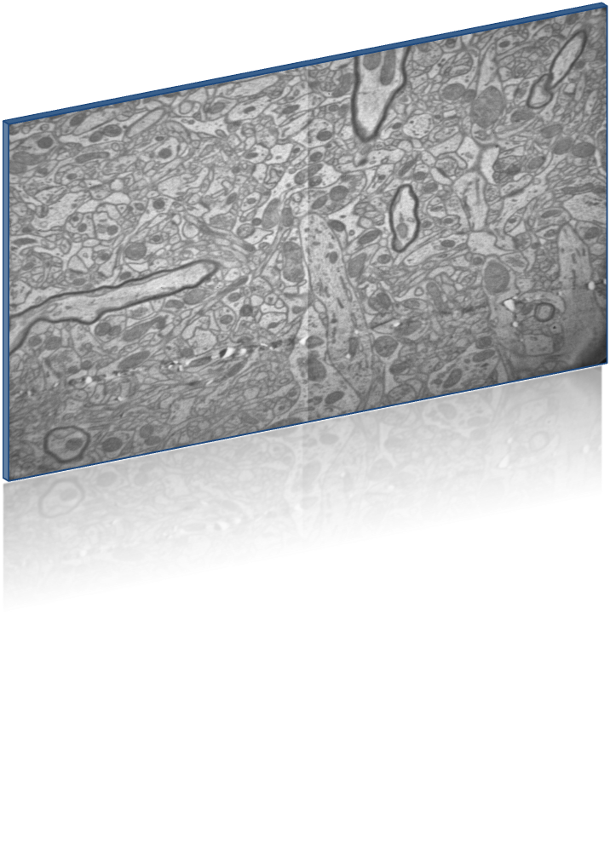
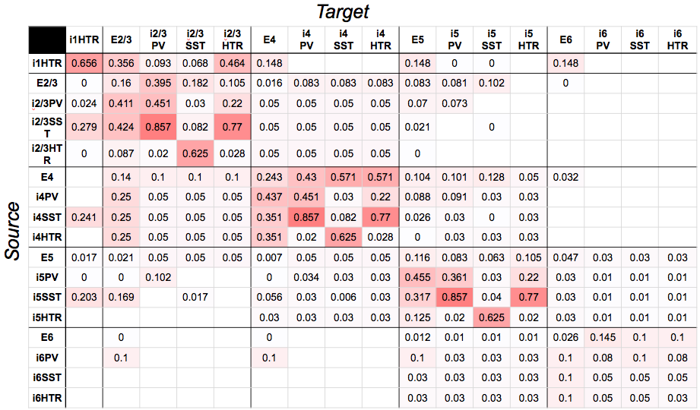
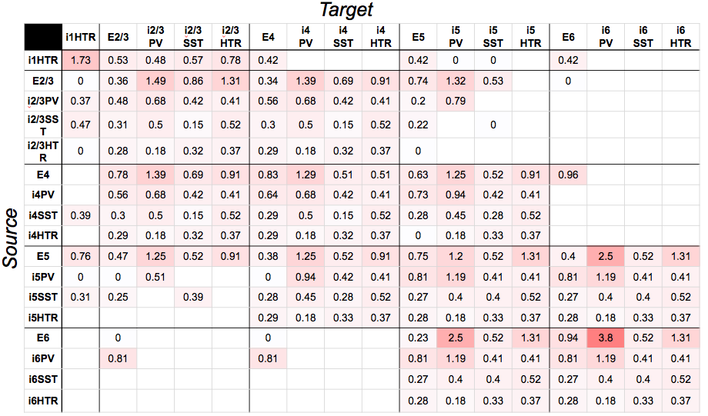
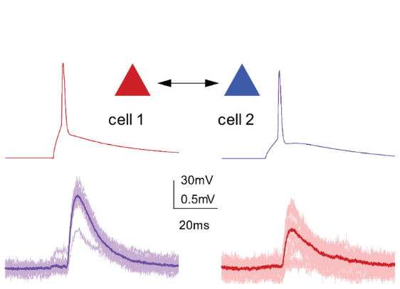
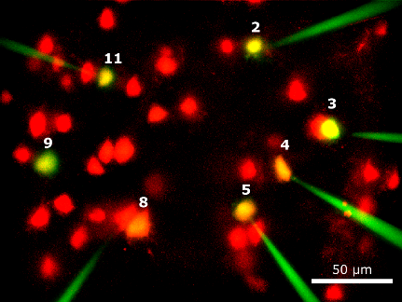
Connectivity
Connection probabilities
Electron Microscopy
Connectomics
Synaptic Strength, unitary PSP (mV)
Multi-patch synaptic physiology
Axonal delays
Synaptic targeting of dendrites
Lee et al., Nature, 2016; Seeman et al., eLife, 2018; Billeh et al., BioRxiv, 2019

Slide 19
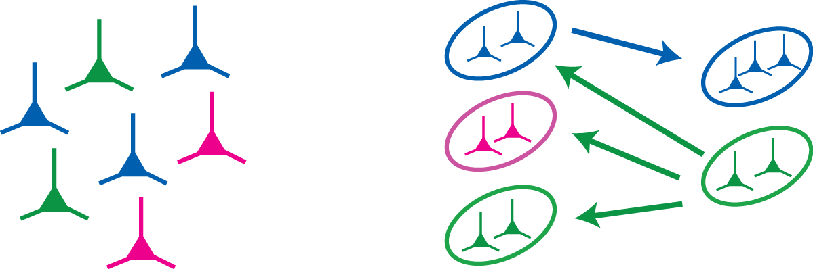
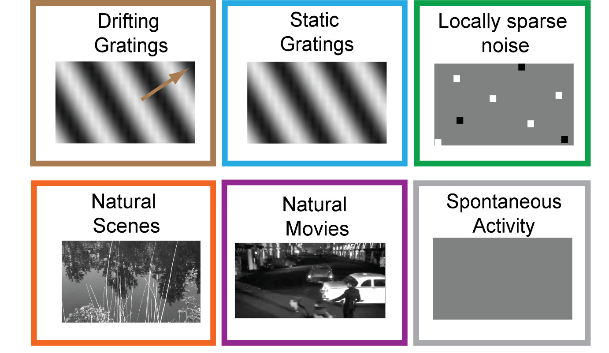
Filter-based Visual Inputs into the V1 model
Sustained LGN pool
Transient LGN pool
V1 neuron
LGN
14 types of LGN cell responses, fit to experimental recordings in vivo
17,400 modeled LGN cells provide inputs to 230,924 V1 cells
Arbitrary visual stimuli (movies) can be processed
Durand et al., J. Neurosci. (2016); de Vries et al., Nat. Neuro, 2019; Arkhipov et al., PLOS Comp. Bio., 2018; Billeh et al., BioRxiv, 2019

Slide 20
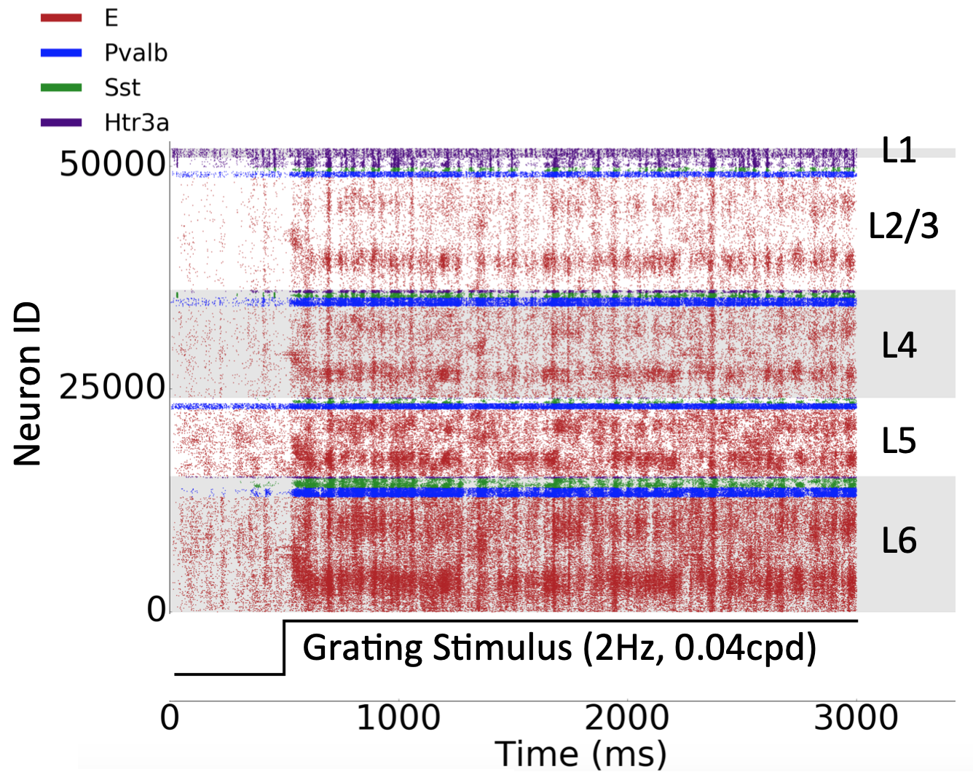
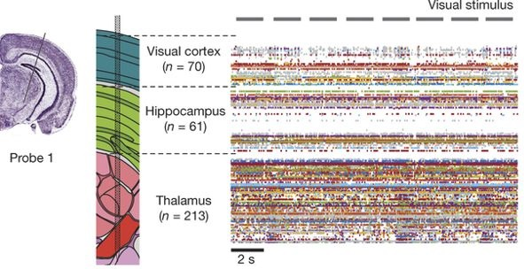
Recording Brain Activity in Vivo Allen Brain Observatory: observatory.brain-map.org
Simulation
de Vries et al., BioRxiv, 2018; Jun et al., Nature, 2017; Garrett et al., BioRxiv, 2019; Billeh et al., BioRxiv, 2019

Slide 21



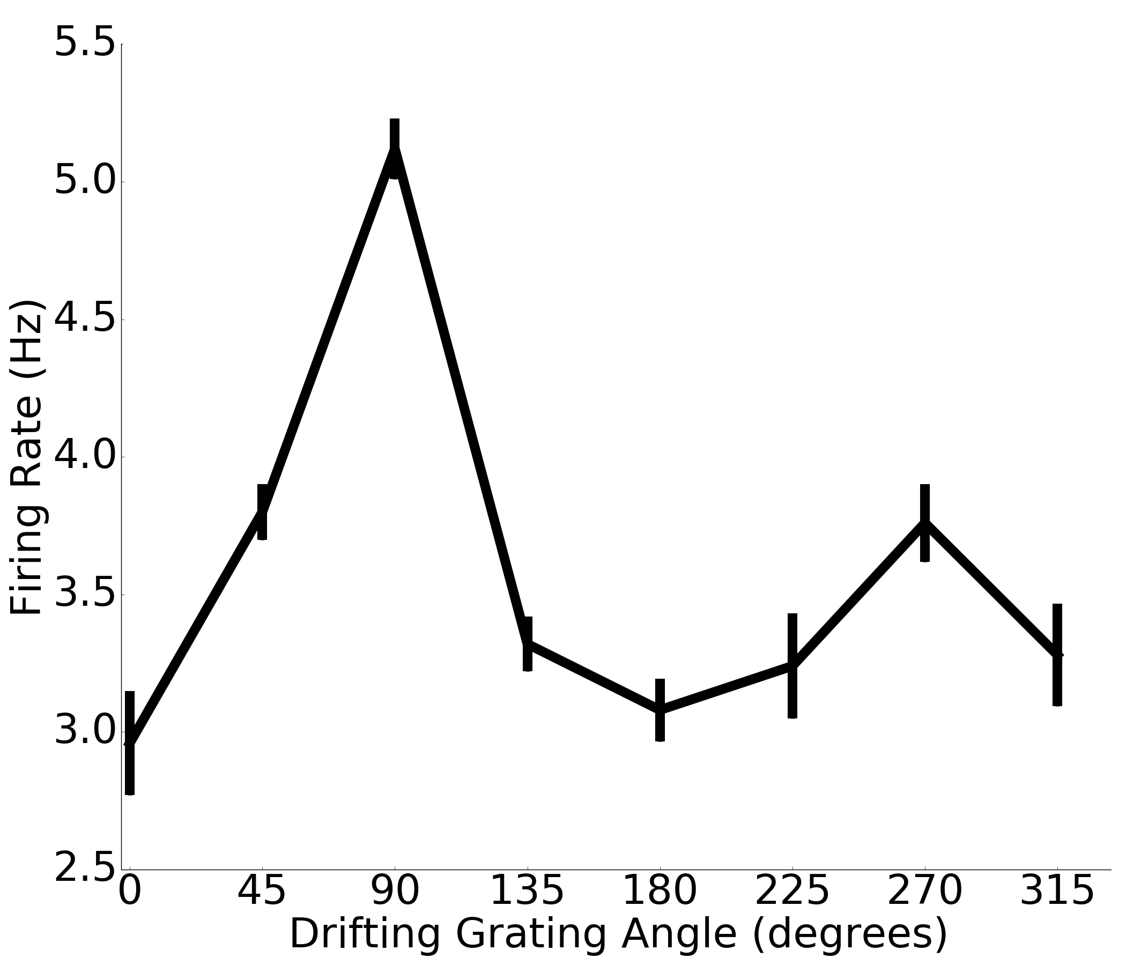





Comparison with Recordings in Vivo Example: Direction Selectivity
90°
135°
45°
180°
0°
225°
315°
270°
Billeh et al., BioRxiv, 2019

Slide 22
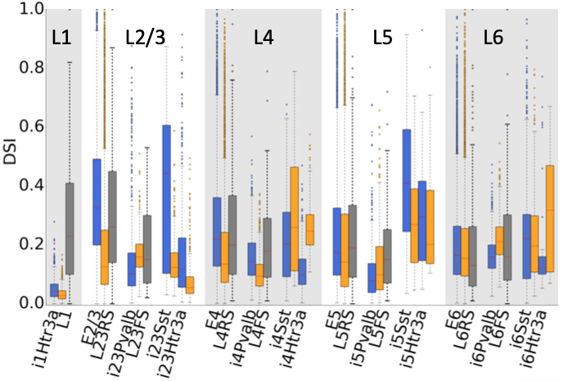
Comparison with Recordings in Vivo Example: Direction Selectivity
Biophysical
DSI: Direction Selectivity Index
Point-neuron
Experiment
Billeh et al., BioRxiv, 2019

Slide 23


Predicting the Logics of Neural Connectivity
Distribution of connections in the Visual Space
Preferred direction
Preferred direction
Connection strength (arb. u.)
Rossi et al., BioRxiv, 2019
10 degrees
Billeh et al., BioRxiv, 2019

Slide 24



Predicting Cell-Type Specific Effects of Optogenetic Perturbations
Perturbation: Silence Layer 4 Excitatory Neurons
50,000
25,000
Normalized activity
Neuron ID
0
0
1000
2000
3000
Time (ms)
Collaboration with the team of S. Mihalas
Cai et al., In prep., 2019

Slide 25

Our Models and Modeling Software Are Freely Available to the Community
Brain Modeling ToolKit (BMTK): https://alleninstitute.github.io/bmtk/

Slide 26

Our Models and Modeling Software Are Freely Available to the Community
Scalable Open Network Architecture TemplAte (SONATA):
https://github.com/AllenInstitute/sonata
An interface between SONATA and the NWB format has been developed as well

Slide 27

Product Program
http://brain-map.org/
BrainTV
Cell Types
Product

Slide 28

Allen Institute’s Databases and Allen Software Development Kit (Allen SDK)
http://brain-map.org/
http://alleninstitute.github.io/AllenSDK/

Slide 29

Our Data, Models, and Software Are Freely Available
Models: http://portal.brain-map.org/explore/models
Brain Modeling ToolKit: https://alleninstitute.github.io/bmtk/
Modeling file format SONATA: https://github.com/AllenInstitute/sonata
http://brain-map.org/

